Slide 1


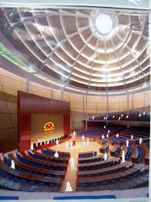
Chính phủ điện tử
TS. Phạm Văn Tính
Khoa CNTT, ĐH Nông Lâm TP.HCM
pvtinh@hcmuaf.edu.vn

Slide 2
Conversion and Validation

Slide 3
Outline
JSF Life-Cycle
Overview of the Conversion and Validation Process
Error Message
Using Standard Converters
Using Standard Validators
Programming with Custom Converters and Validators

Slide 4
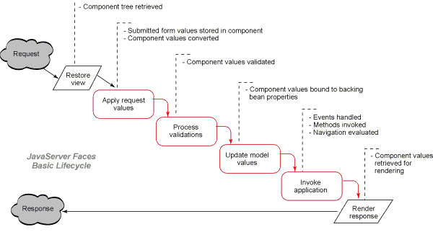
JSF Life-Cycle

Slide 5
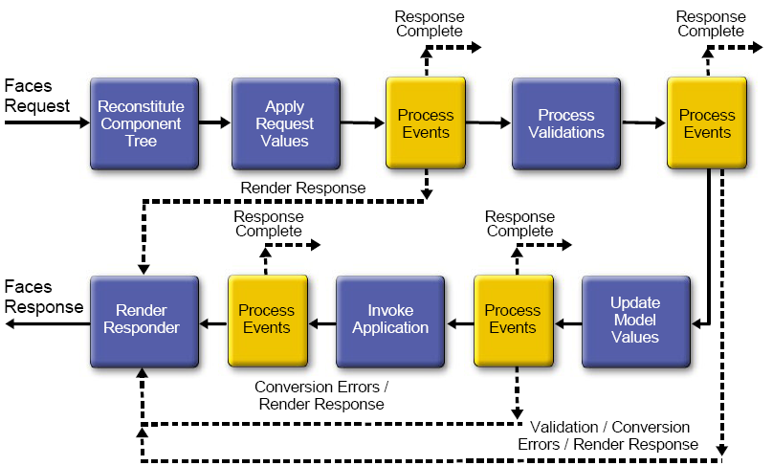
JSF Life-Cycle

Slide 6
Phases of JSF life cycle
Restore View: recreates the server-side component tree when you revisit a JSF page.
Apply Request Values: copies request parameters into component submitted values.
Process Validations: first converts those submitted values and validates the converted value.
Update Model Values: copies converted and validated values to the model, which is typically denoted in JSF pages with value reference expressions, such as:
<h:inputText value="#{user.age}"/>
Invoke Application: invokes action listeners and actions, in that order, for command components.
Render Response: saves state and loads the next view. The JSF navigation handler forwards or redirects to another JSP page.

Slide 7
Conversion and Validation Process
Look at user input as it travels from the browser form to the beans that make up the business logic.
The user fills in a field of a web form then submit to send the form data - called the request value - to the server
In the "Apply Request Values" phase, the request values are stored in component objects and is called the submitted value.
A conversion process transforms the incoming strings to types of the web application such as int, Date, ... The converted values are stored and validated inside the component objects.
After being validated, the "Update Model Values" phase starts, and the local values are stored in beans, as specified by their value references.

Slide 8
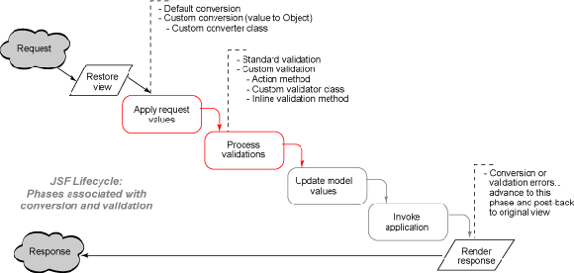
Conversion and validation phases

Slide 9
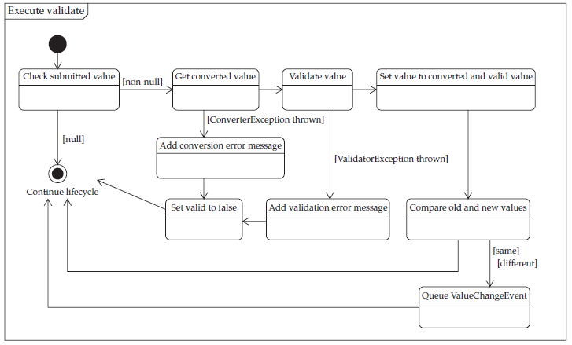
How conversion and validation are performed

Slide 10
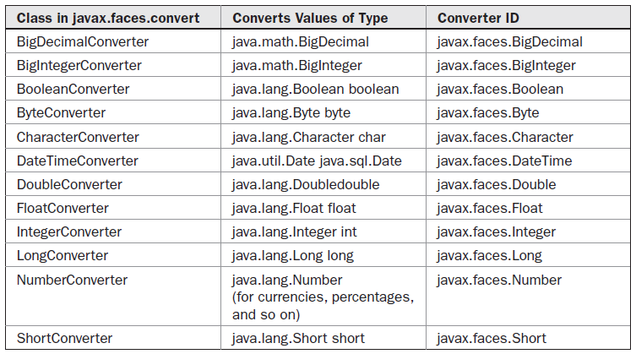
JSF Standard Converters

Slide 11
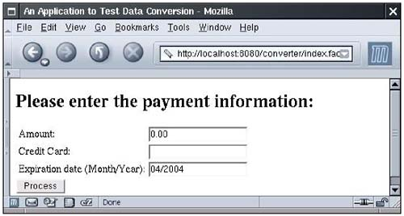
Using Standard Converters
Example: a web application that is used to process payments. The payment data includes
the amount to be charged
the credit card number
the credit card expiration date

Slide 12
Conversion of Numbers and Dates
We attach a converter to the payment amount textfield and tell it to format the current value with at least two digits after the decimal point:
<h:inputText value="#{payment.amount}"> <f:convertNumber minFractionDigits="2"/> </h:inputText>
The expired date field uses an f:datetime converter whose pattern attribute is set to the string MM/yyyy.
<h:inputText value="#{payment.date}"> <f:convertDateTime pattern="MM/yyyy"/> </h:inputText>

Slide 13
JSF 2 convertNumber example
In JSF, “f:convertNumber” is a standard converter, which converts String into a specified “Number” format. In addition, it’s also used as a validator to make sure the input value is a valid number. See following common used examples :
Note : Assuming #{receipt.amount} contains a “0.1” value.

Slide 14
JSF 2 convertNumber example
1. minFractionDigits attribute
<h:outputText value="#{receipt.amount}" > <f:convertNumber minFractionDigits="2”/> </h:outputText>
Display the value as “0.10″.
2. pattern attribute
<h:outputText value="#{receipt.amount}" > <f:convertNumber pattern="#0.000" /> </h:outputText>
Display the value as “0.100″.
Note The pattern format is defined in java.text.DecimalFormat

Slide 15
JSF 2 convertNumber example
3. currencyCode attribute
<h:outputText value="#{receipt.amount}" > <f:convertNumber currencyCode="GBP" type="currency" /> </h:outputText>
Display the value as “GBP0.10″.
Note: The currencyCode is defined in ISO 4217.
4. type=”percent” attribute
<h:outputText value="#{receipt.amount}" > <f:convertNumber type="percent" /> </h:outputText>
Display the value as “10%”.

Slide 16
JSF 2 convertNumber example
@ManagedBean(name="receipt") @SessionScoped public class ReceiptBean implements Serializable{ double amount; public double getAmount() { return amount; } public void setAmount(double amount) { this.amount = amount; } }

Slide 17
Attributes of the f:convertNumber
Attribute | Type | Value
type | String | number (default), currency, or percent
pattern | String | Formatting pattern, as defined in java.text.DecimalFormat
maxFractionDigits | int | Maximum number of digits in the fractional part
minFractionDigits | int | Minimum number of digits in the fractional part
maxIntegerDigits | int | Maximum number of digits in the integer part
minIntegerDigits | int | Minimum number of digits in the integer part
integerOnly | boolean | true if only the integer part is parsed (default: false)
groupingUsed | boolean | True if grouping separators are used (default: true)
locale | java.util.Locale | Locale whose preferences are to be used for parsing and formatting
currencyCode | String | ISO 4217 currency code to use when converting currency values
currencySymbol | String | Currency symbol to use when converting currency values

Slide 18
Attributes of the f:convertDateTime
Attribute | Type | Value
type | String | Date (default), time, or both
dateStyle | String | default, short, medium, long, or full
timeStyle | String | default, short, medium, long, or full
pattern | String | Formatting pattern, as defined in java.text.SimpleDateFormat
locale | java.util.Locale | Locale whose preferences are to be used for parsing and formatting
timeZone | java.util.TimeZone | Time zone to use for parsing and formatting
If you use a value binding whose type is either a primitive type, then you don't need to specify any converter. The JSF implementation automatically picks a standard converter.
However, you need to specify an explicit converter for Date values.

Slide 19
The converter Attribute
An alternate syntax for attaching a converter to a component is to add the converter attribute and ID of the converter
<h:outputText value="#{payment.date}" converter="javax.faces.DateTime"/>
This is equivalent to:
<h:outputText value="#{payment.date}"> <f:convertDateTime/> </h:outputText>
Converters with predefined IDs:
javax.faces.DateTime, javax.faces.Number, javax.faces.Boolean, javax.faces.Byte, javax.faces.Character, javax.faces.Double, javax.faces.Float, javax.faces.Integer, javax.faces.Long, javax.faces.Short, javax.faces.BigDecimal,javax.faces.BigInteger

Slide 20
Using Standard Validators
JavaServer Faces has built-in mechanisms that let you carry out the following validations:
Checking the length of a string
Checking limits for a numerical value
Checking that a value has been supplied
For example, to check limits for a numerical value, you use a range validator:
<h:inputText value="#{payment.amount}“> <f:validateLongRange minimum="10" maximum="10000"/> </h:inputText>

Slide 21
Standard Validators
JSP Tag | Attributes | Validates
f:validateDoubleRange | minimum, maximum | a double value within an optional range
f:validateLongRange | minimum, maximum | a long value within an optional range
f:validateLength | minimum, maximum | a String with a minimum and maximum number of characters
All the standard validator tags have minimum and maximum attributes. You need to supply one or both of these attributes.

Slide 22
Checking for Required Values
To check that a value is supplied, you supply the attribute required="true":
<h:inputText value="#{payment.date}" required="true"/>
All JSF input tags support the required attribute.
You can combine the required attribute with a nested validator:
<h:inputText value="#{payment.card}" required="true"> <f:validateLength minimum="13"/> </h:inputText>
CAUTION: If the required attribute is not set and a user supplies a blank input, then no validation occurs at all! Instead, the blank input is interpreted as a request to leave the existing value unchanged.

Slide 23
Validation Approaches
Manual validation
Use string properties for bean
Do validation in setter methods and/or action controller
Return null to redisplay form
Create custom error messages and store in FacesMessage
Use h:messages to display list of error messages
Implicit automatic validation
Use int, double, etc. bean properties. Or add required.
System redisplays form if there is conversion error
Use h:message to display field-specific error message

Slide 24
Validation Approaches
Explicit automatic validation
Use f:validateLength, f:validateDoubleRange, f:validateLongRange, or f:validateRegex
System redisplays form if failure; use h:message again
Custom validation methods
Create FacesMessage, wrap in ValidatorException

Slide 25
Conversion and Validation Errors
When a conversion or validation error occurs, the following actions are the result:
The component whose conversion/validation failed posts a message and declares itself invalid.
The JSF implementation redisplays the current page immediately after the "Process Validations" phase has completed.
To to show the error messages to the components use h:message and h:messages tag

Slide 26
Displaying Error Messages
h:message tag show the error messages next to the components that reported them.
<h:inputText id="amount" value="#{payment.amount}"/> <h:message for="amount"/>
A message has two parts: summary and detail. By default, the h:message tag shows the detail. If you want to show the summary message instead, use:
<h:message for="amount" showSummary="true" showDetail="false"/>
You use the styleClass or style attribute to change the appearance of the error message:
<h:messages styleClass="errorMessage"/> or <h:message for="amount" style="color:red"/>

Slide 27
Displaying All Error Messages
show a listing of all messages from all components using the h:messages tag.
By default, the h:messages tag shows the message summary but not the message detail.
you can layout attribute the messages are lined up vertically. Otherwise they are simply concatenated.
<h:messages layout="table"/>

Slide 28
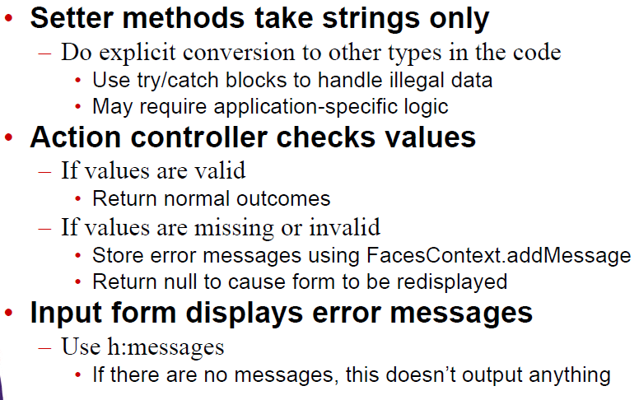
Manual Validation

Slide 29
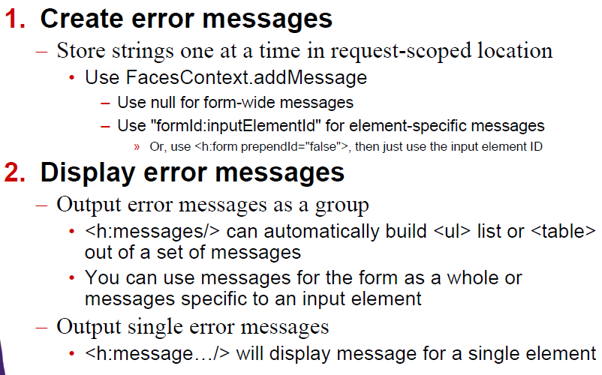
Standard System for Error Messages

Slide 30
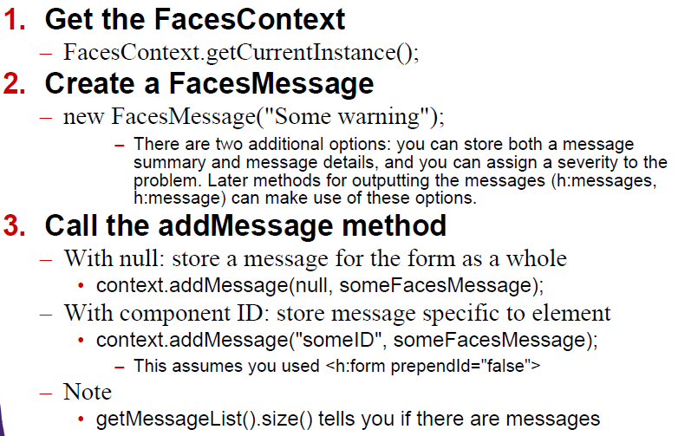
Creating Error Messages: Details

Slide 31
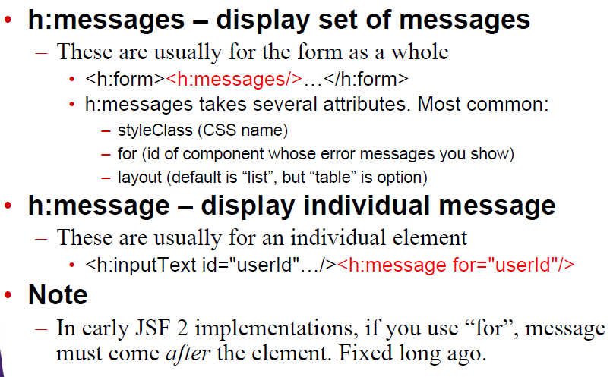
Displaying Error Messages: Details

Slide 32
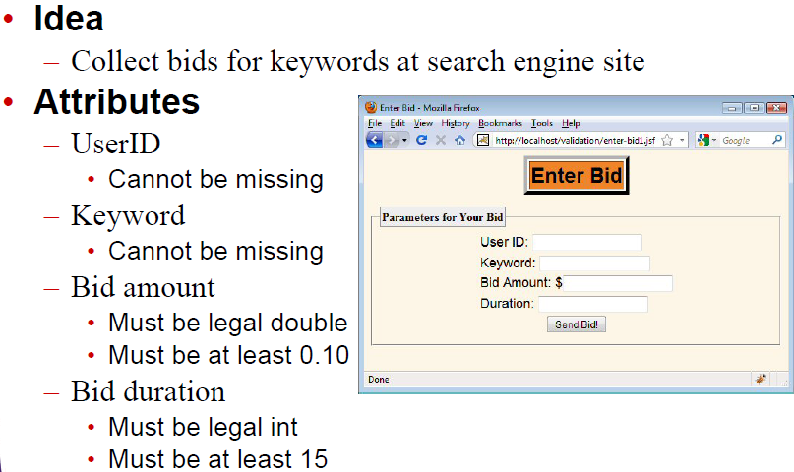
Manual Validation: Example

Slide 33
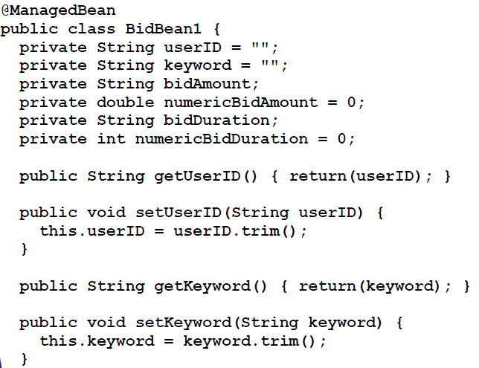
Bean Code: String Properties (No Conversion)

Slide 34
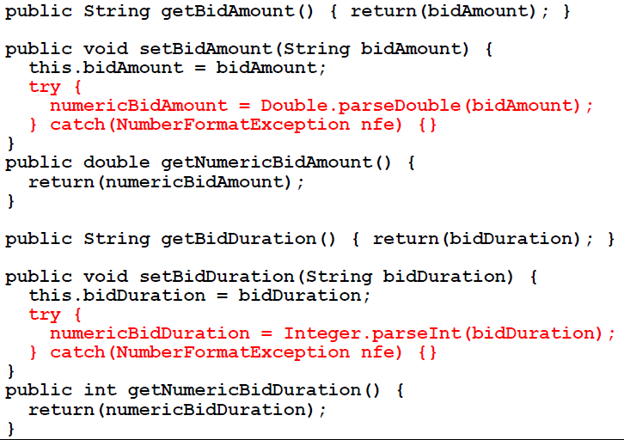
Bean Code: Numeric Properties (Conversion)

Slide 35
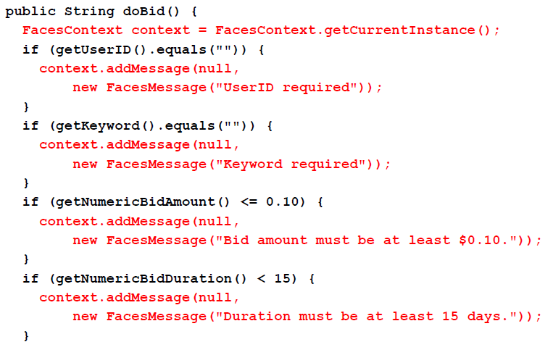
Bean Code: Action Controller

Slide 36
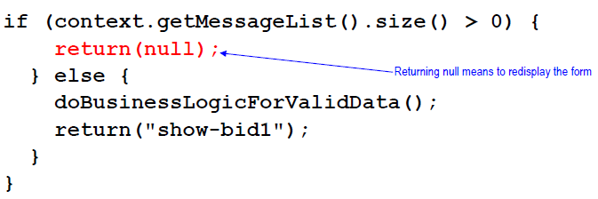

Bean Code: Action Controller (Continued)

Slide 37
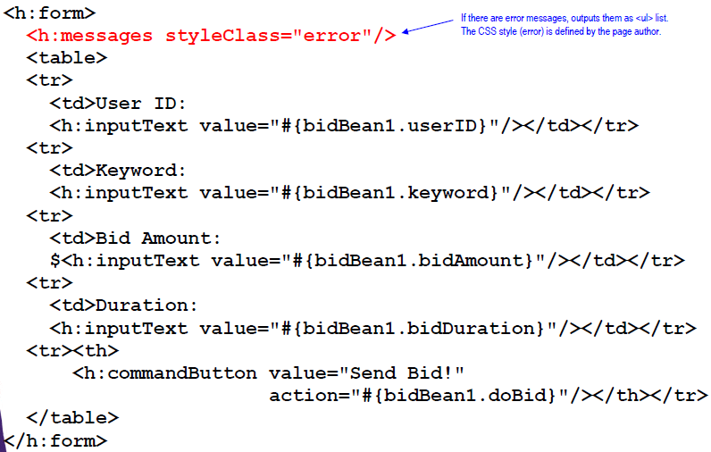

Input Form: Displaying Error Messages (enter-bid1.xhtml)

Slide 38
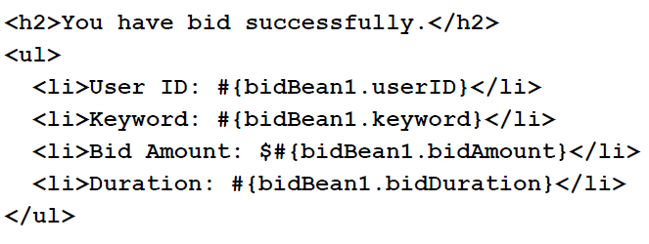
Results Page (show-bid1.xhtml)

Slide 39
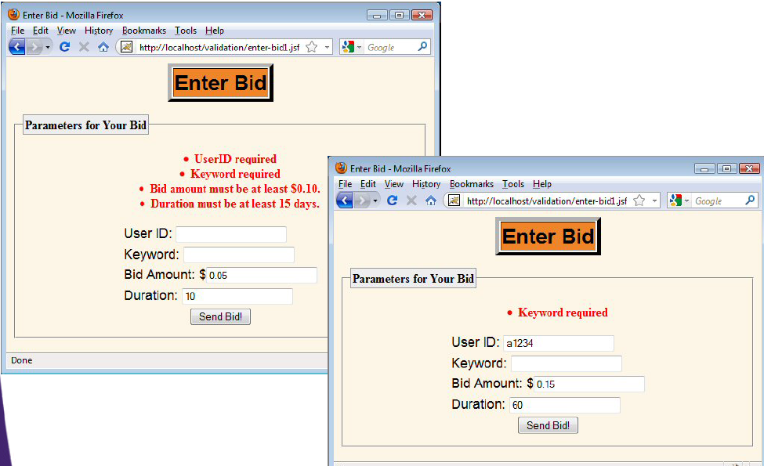
Manual Validation: Results (Bad Input)

Slide 40
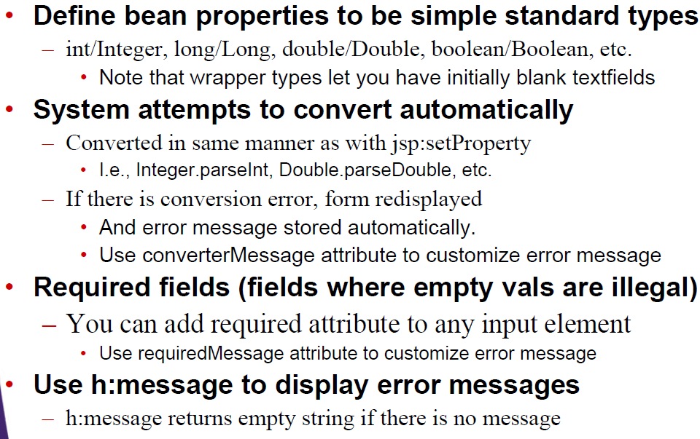
Implicit Automatic Validation

Slide 41
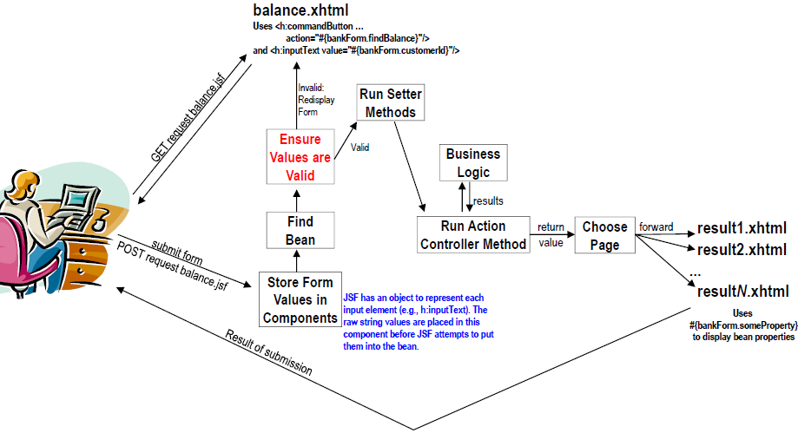
JSF Flow of Control

Slide 42
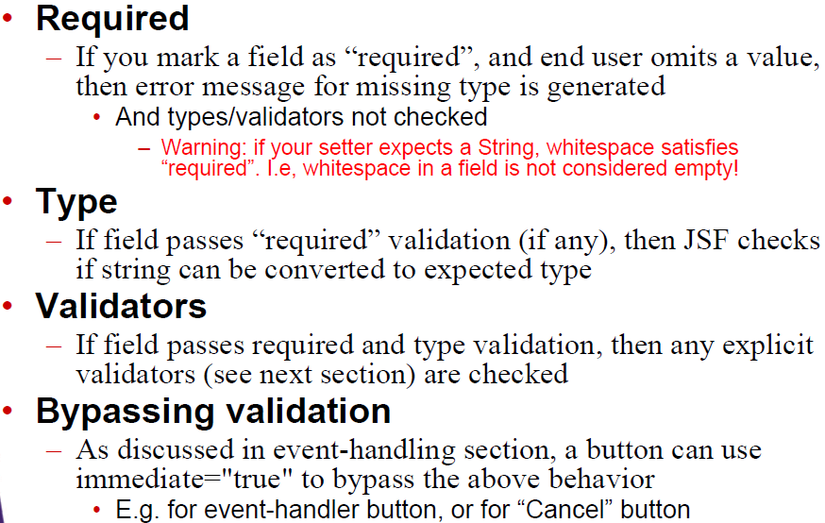
Precedence of Validity Tests

Slide 43
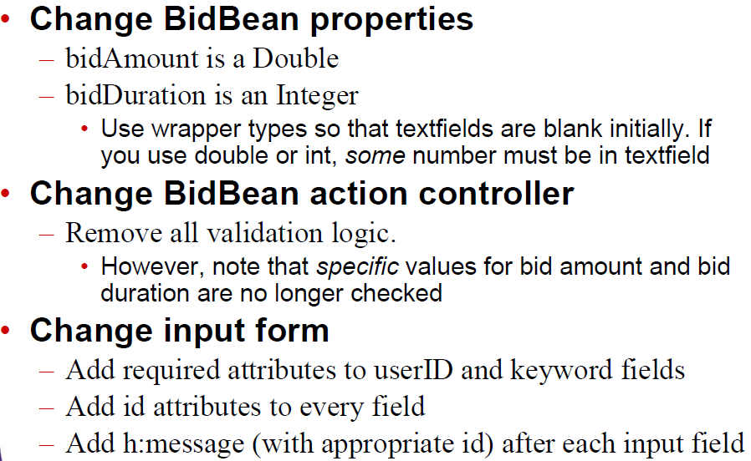
Implicit Validation: Example

Slide 44
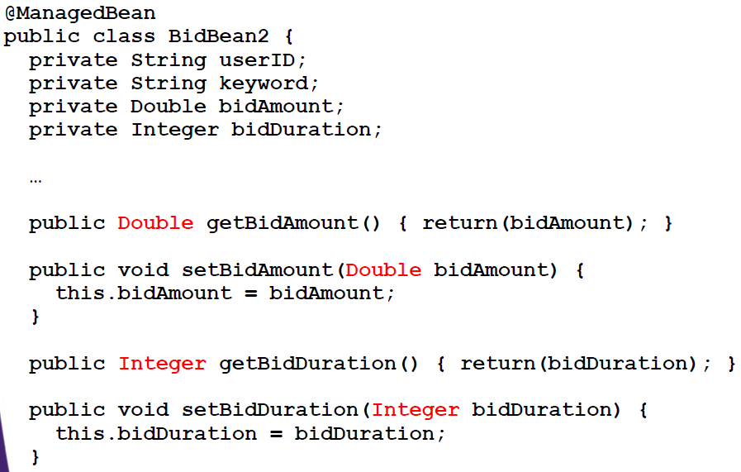
Bean Code: Properties

Slide 45
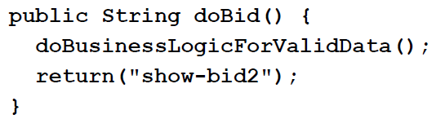
Bean Code: Action Controller
No validation logic in the action controller, so action controller can concentrate on business logic

Slide 46
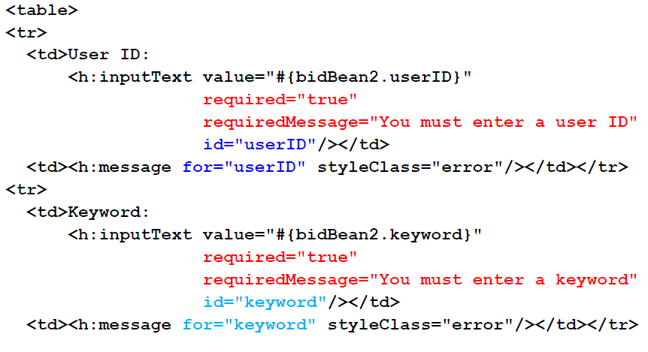
Input Form: Top (enter-bid2.xhtml)

Slide 47
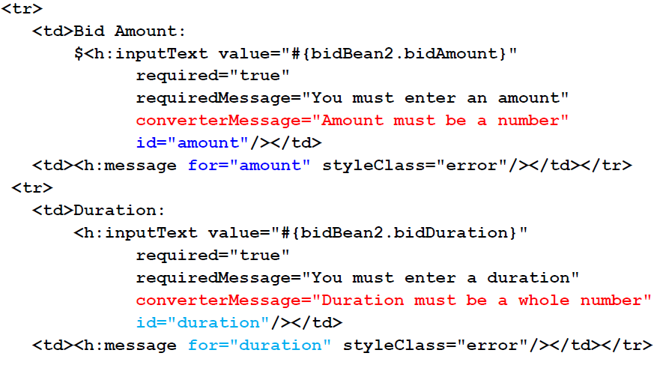
Input Form: Continued (enter-bid2.xhtml)

Slide 48
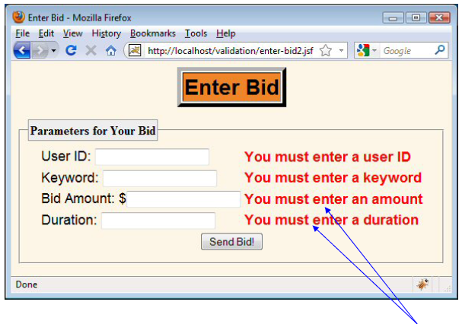
Results (Bad Input)
Since tests for required attributes take precedence over tests for proper types, the requiredMessage attribute is displayed here

Slide 49
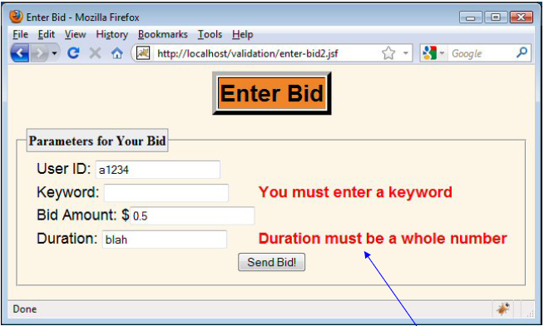
Results (Bad Input)
Since the value passes the required test, the type test is applied

Slide 50
JSF Standard Validators
JSP Tag | Attributes | Validates
f:validateDoubleRange | minimum, maximum | a double value within an optional range
f:validateLongRange | minimum, maximum | a long value within an optional range
f:validateLength | minimum, maximum | a String with a minimum and maximum number of characters
All the standard validator tags have minimum and maximum attributes. You need to supply one or both of these attributes.

Slide 51
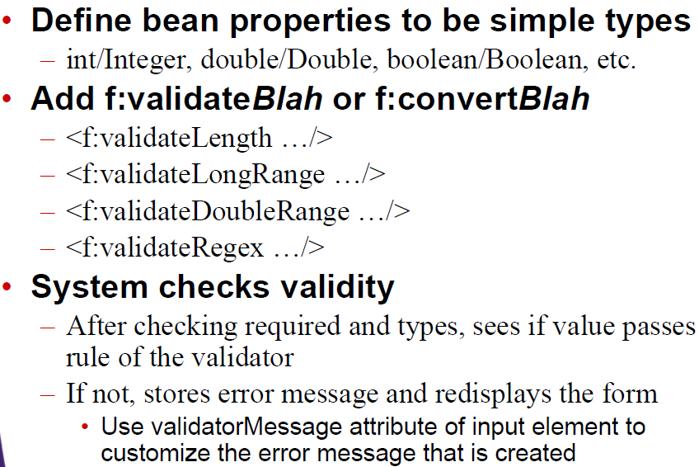
Explicit Automatic Validation

Slide 52
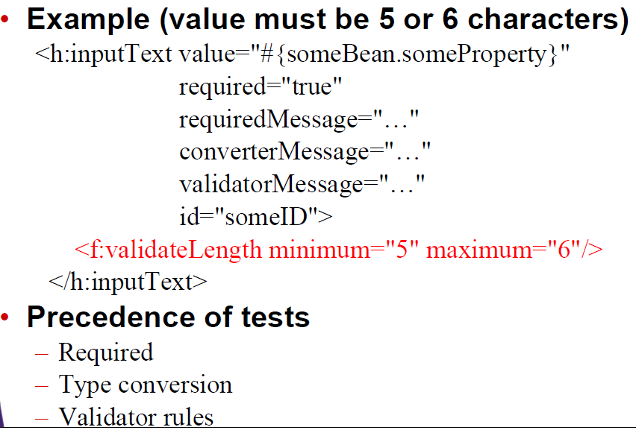
General Format for Validator Tags

Slide 53
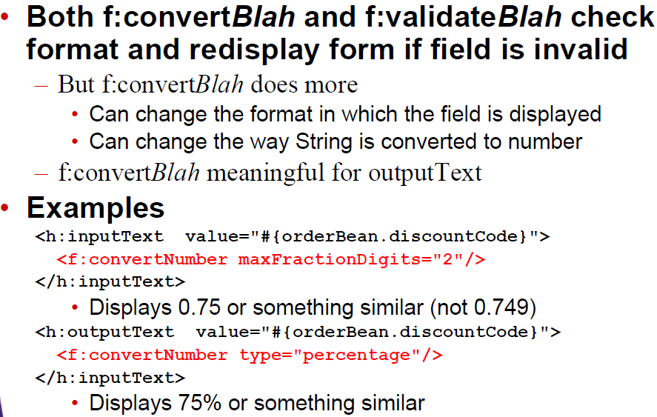
Conversion vs. Validation

Slide 54
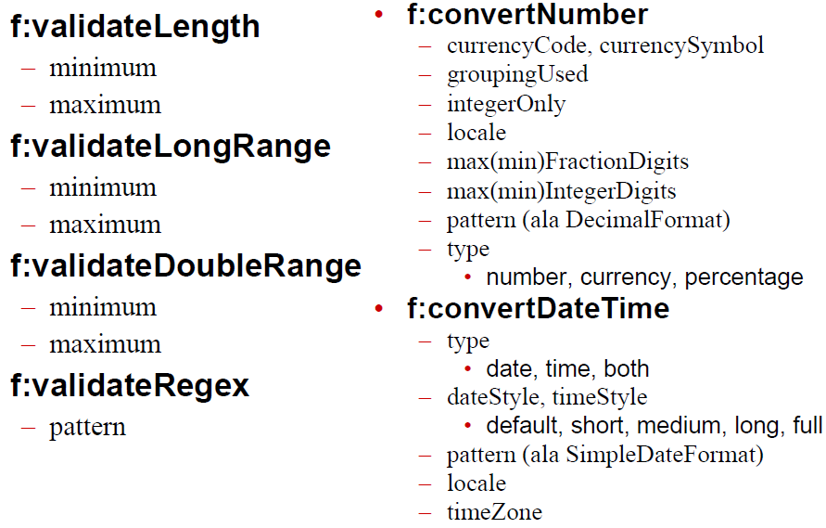
Main Validator and Converter Attributes

Slide 55
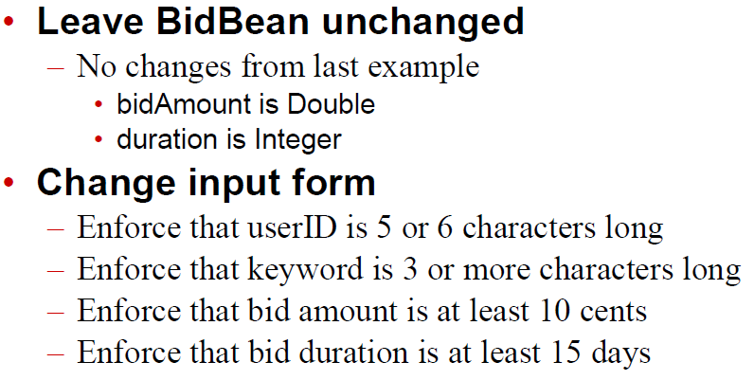
Explicit Validation: Example

Slide 56
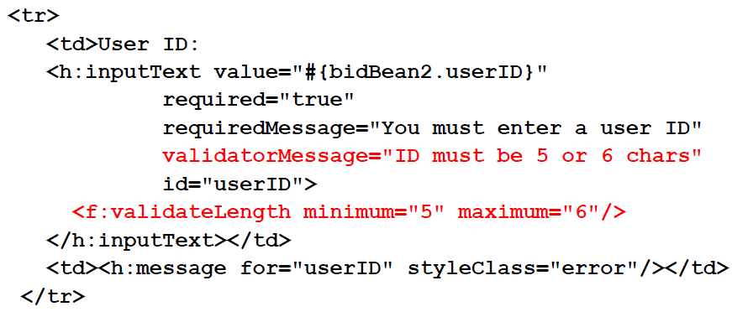
Input Form: User ID (enter-bid3.xhtml)

Slide 57
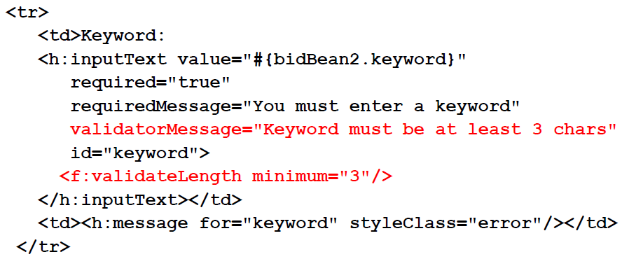
Input Form: Keyword (enter-bid3.xhtml)

Slide 58
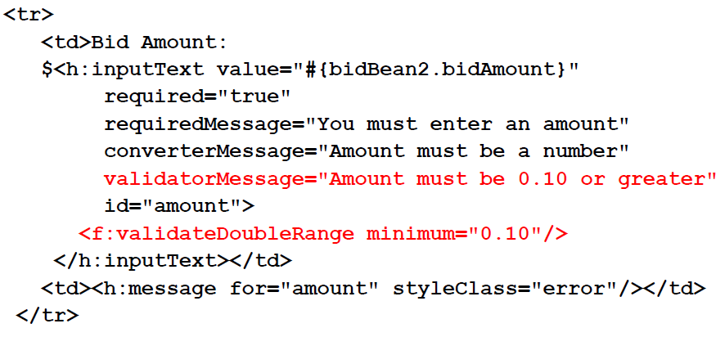
Input Form: Bid Amount (enter-bid3.xhtml)

Slide 59
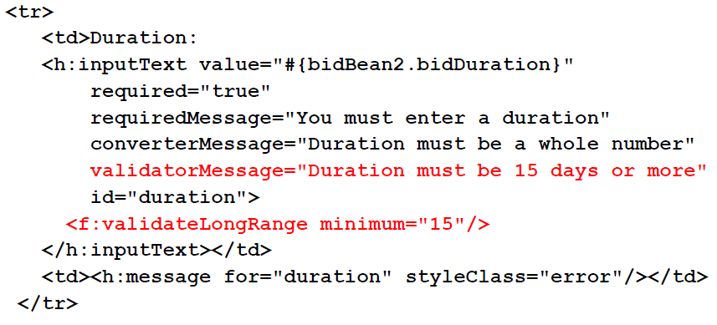
Input Form: Bid Duration (enter-bid3.xhtml)

Slide 60
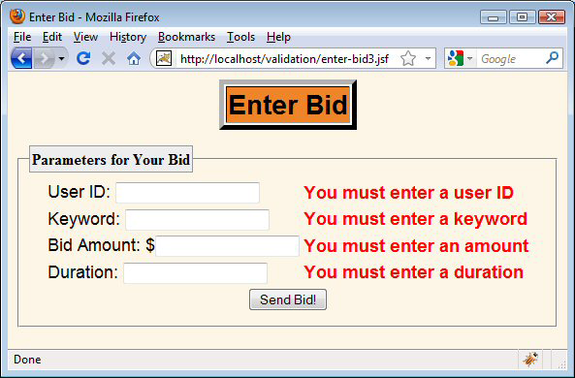
Results (Missing Data)

Slide 61
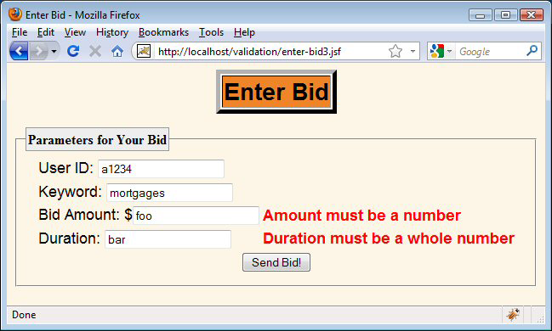
Results (Type Conversion Errors)

Slide 62
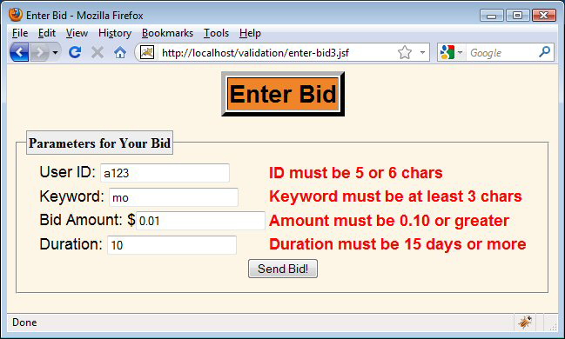
Results (Explicit Validation Errors)

